Slide 1

Town Hall
NARS | LCS | RC
July 25, 2024

Slide 2

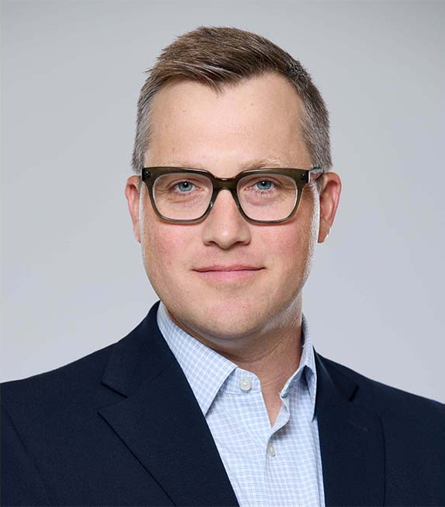




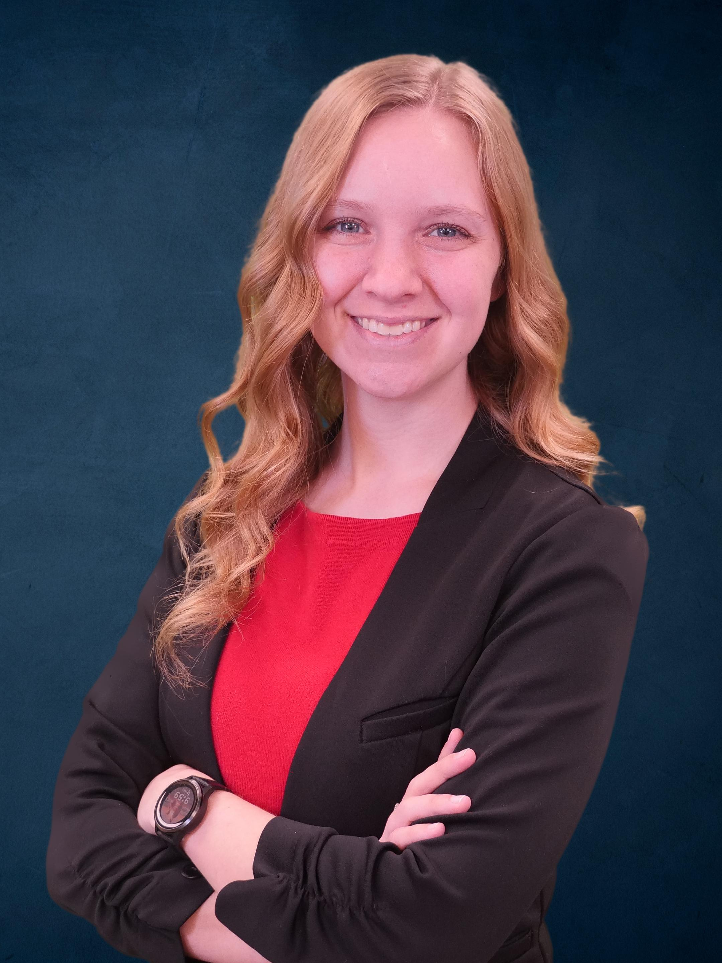

Agenda & Today’s Speakers
Agenda
Speaker: Nick Arch
North American Residential Solutions
Nick Arch
VP & GM, NARS
Strategic Plan
Tim Paciorek
Director Sales, Carrier Enterprise Key Wins & Sales Update
Braden Cook
Sr. Dir, Product Mgmt, Training, & Service
Residential Product Roadmap
Ben Cowles
Senior Director, NARS CFO
Key Financials
Light Commercial
Replacement Components
Heidi
Gehring
Managing Dir, Americas LCS
Strategic Plan
Ashlee Craven
Manager, Americas LCS Finance
Key Financials
Tom Archer
RC Sales Leader
Key Financials
and Priorities
Proprietary and Confidential

Slide 3



Hydronics Org Announcement
NARS Strategic Plan
Speaker: Nick Arch
RLC EMEA
NARS
Burners &
Industrial System solutions
Burners
Jet burner boilers
LCML boilers
NARS
RES boilers
LCML boilers
RES hydronic HPs
Indirect water tanks
Hydronics NA
RES boilers
LCML boilers
RES hydronic HPs
Indirect water tanks

Slide 4




Strategic Focus Areas
NARS Strategic Plan
Speaker: Nick Arch
Grow the Core
Defend the Base
Optimize the Channel
Expand Solutions
Develop profitable, regulatory compliant products
Drive share gains through affordable, differentiated solutions
Capture 100% AOR replacements
Prevent disintermediation
Defend NA share against low-cost Asian entrants
Improve our performance as a supplier
Hold customers accountable for performance
Increase attachment rates for our full
portfolio of products
Provide dealers with complementary products to sell at the kitchen table
Proprietary and Confidential

Slide 5












Key Wins & Initiatives
NARS Sales Update
Speaker: Tim Paciorek
Drive Profitable Growth
Return to Fundamentals
Expand Opportunities
Finalize Conversions
Targeted dealer conversions
Distributor scorecards
D360 Planning
Capture Market Share
Notes:
First, we want to build upon in some regions and begin the process in other regions of Target dealer reviews and progress tracking to drive more dealer conversions across distribution focusing in the AOR space.
The Sales operations team will also be rolling out the D360 planning/Forecast tool to allow the sales team to have more SKU targeted conversations around customer Sales, inventory and ordering patterns. Barbara and Megan have been leading that effort
As we focus on some of the key initiatives the back-half of this year and into 2025 we want to continue to Expand distribution opportunities
We are expanding with Chadwell and HD Supply in the MRO segment
Johnstone supply converted 6 Branches in Oakland
First Supply – DLS conversion in WI and MN
Finally we are finalizing the conversions for some major wins
Walmart – 25-40M Bryant opportunity next year
We are gathering a lot of learnings from the pilot regions that have begun working with Walmart. The Focus for the the Bryant channel over the next 6 months is to Identify Bryant dealers in each region that can support this opportunity. Margo and Gavin are focused on turning on as many regions as possible the next 2-3 months to cover at least 60% of the zip-codes they operate in.
Champion Homes – 40-50M ICP opportunity in the Manufactured housing segment. Mike Barnes and the National accounts team has done a great job on-boarding. By the end of Q3 we will be shipping our product to all 41 of there sites. This gives us a partnership with both the number 1 and number 2 builders in the Manufactured housing segment. Clayton Homes being number 1
Sibi -40-100M Payne/ICP opportunity. For those that don’t know SIBI their company is focused on simplifying the process of building and improving a property by connecting manufacturers, contractors, and homeowners directly on one platform. They are in the Property Management/HomeWarranty/Hospitality segment. This was a key strategic win by the national accounts team in a segment we did not actively participate in at this level.

Slide 6
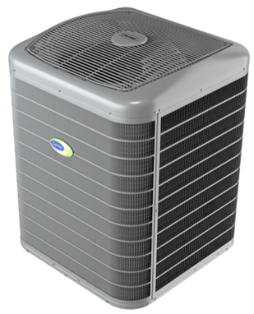
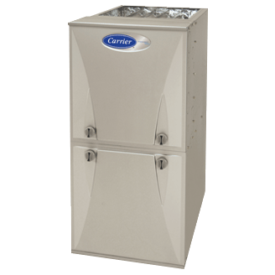
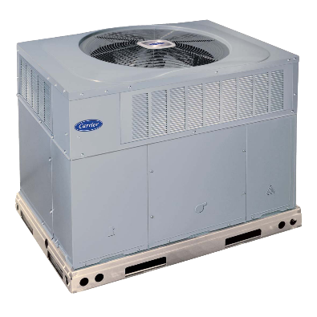
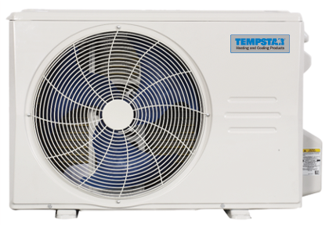
Sales Update
NARS Sales Update
Speaker: Tim Paciorek
DUCTED SPLITS
GAS FURNACES
SPP
DLS
Share
Share
Share
Share
Rolling 12 32%
Year-over-Year +30 bps
Rolling 12 29.6%
Year-over-Year +110 bps
Rolling 12 28.6%
Year-over-Year +90 bps
Rolling 12 19.3%
Year-over-Year +480 bps
Successes
Watch Items
Share gains across the product lines
Markets rebounding from soft ‘23
Distributor movement
RNC – SF/MF market
Product mix
Regulatory transition (R-410A → R-454B)
Data - May YTD
Proprietary and Confidential
Notes:
I want to provide a quick update on overall Share performance: As we know share is the ultimate indicator of how we are performing in the market against our competition.

Slide 7
Residential
Product Roadmap

Slide 8




2025 Refrigerant Changes
NARS Roadmap
Speaker: Braden Cook
Launch Status*
Carrier Strategy
 |  |  |  |  | 2024 |  |  |  | 2025
Product |  | Description | Status |  | 1Q | 2Q | 3Q | 4Q | 1Q | 2Q | 3Q | 4Q
Outdoor | 1-stg | 15 SEER HP | ✓ |  |  | APR
 |  | 15 SEER South AC |  |  |  |  | SEPT
 |  | 14 SEER North AC |  |  |  |  |  |  | JAN
 |  | 3 phase HP |  |  |  |  |  | NOV
 |  | 3 phase AC, Odd HP |  |  |  |  |  |  |  |  | OCT
 | 2-stg | 18 SEER 2-stg HP |  |  |  |  |  | NOV
 |  | 18 SEER 2-stg AC |  |  |  |  |  |  | JAN
 | VS | Tetra, NGRIP, DOE CCHP |  |  |  |  |  | NOV
Indoor | Fan Coil | MF Wall Mount | ✓ |  |  | May
 |  | MF Ceiling Hung |  |  |  |  | SEP
 |  | Entry | ✓ |  |  | APR
 |  | Mid/Dlx |  |  |  |  | SEP
 | Furn Coil | V, A, Slab | ✓ |  |  | APR
SPP | SPP | Entry MH HP / AC |  |  |  |  |  | DEC
 |  | Entry G AC/HP |  |  |  |  |  | DEC
 |  | Mid G AC / HP |  |  |  |  |  |  |  | JUN
DLS/VRF | DLS | Single-Zone & IDU |  |  |  |  |  | OCT
 | DLS | Multi-Zone, Crossover |  |  |  |  |  | NOV
 | DLS | Toshiba RAV |  |  |  |  |  | DEC
 | Mini-VRF | Toshiba, Midea |  |  |  |  |  |  | FEB
Lead:
First to select R-454B (2018)
Channel communications and training
First to post R-454B ratings and ship equipment
Differentiate:
QR code on unit to easily access transition information
R-454B required components included with coil
InteliSense expansion
DOE CCHP
Braze-less line set connections
Mechanical TXV connections
Bluetooth (deluxe)
Improve:
Revenue growth
Crossover offering
IRA ratings
Fully variable speed offering
~$90M Investment ➔ >$400M annual sales growth
*Dates based on first ship

Slide 9



RES 5Y Roadmap – Key Products
NARS Roadmap
Speaker: Braden Cook
Sales Growth
Product Development Timeline
Incrmntl 2029 vs. 2024 Sales ($M)
2024
2025
2026
2027
2028
'29
Whole home
Battery & Solar
Fan Coil
Battery
Home Energy Management Solutions
(HEMS)
eDragon Entry
eDragon Mid/Deluxe
$335
VPP
VPP Expansion
Tankless
HPWH
Domestic
Hot Water
A2A HP
$100
Entry RES Boiler
Entry InteliSense
Builder
Controls¹
Refresh
$75
ecobee Replacement
Infinity
Mid
Entry
Next Gen Fan Coil
Deluxe
$125
Mid/entry inverter
Mid HP
Entry AC/HP
Mini + Deluxe AC/HP
$130
Cold Climate HP
DOE
Cascade
$50
2025
2029
Key Programs Drive $1.7B Cumulative Growth 2025 - 2029
¹ RC P&L
CONFIDENTIAL

Slide 10


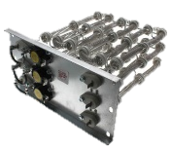

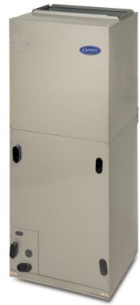
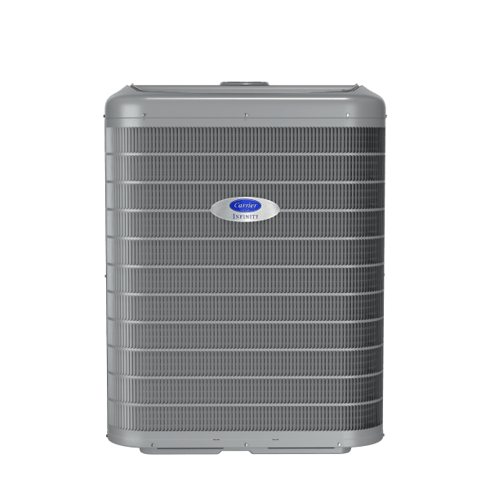
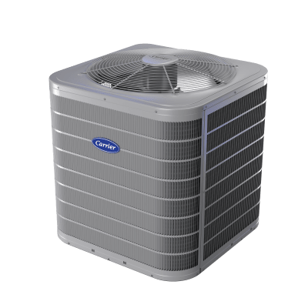
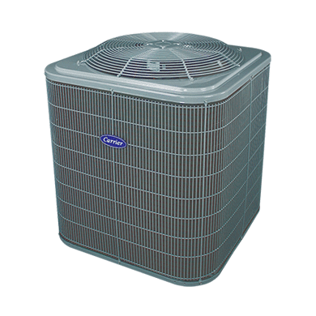
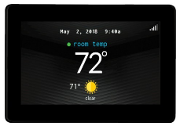


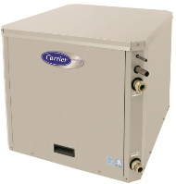
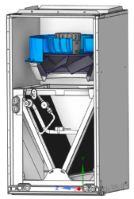



Differentiation Transformation
NARS Roadmap
Speaker: Braden Cook
Deluxe
Mid
Entry
Key
Programs
2024
1
CCHP
Cascade
Data
Data
Mid/entry inverter
2-way
2-way
On / Off
On / Off
On / Off
On / Off
2
3
Next Gen Fan Coil
2029
4
T-stats
1
5
1
5
1
5
A2A HP
Water Htg
5
6
HEMS
2-way
2-way
2-way
2-way
2-way
2-way
2
6
3
4
1
3
4
2
6
3
4
2
6
Complete Line-up of Intelligent and Electrified Solutions
CONFIDENTIAL

Slide 11
Financial Update

Slide 12


2024 NARS Financials
NARS Financial Update
Speaker: Ben Cowles
1H Actuals
2H Outlook
FY Forecast
Vs Plan
Key Takeaways
+
Positive Share Growth
Margin Expansion
Record Q2
Sales
+HSD% VPY
Organic
VPY% Flat HDD%
?
Movement
Pricing Pressures
Operating Profit
+HDD% VPY
Organic
VPY% 9% (23%) HDD%
–
Free Cash Flow
Product Mix
Supply continuity
+HDD% VPY
Organic
VPY% 81% (23%) HGHDD%
Proprietary and Confidential
Notes:
1H:
Relatively decent performance to start the year
H1 sales flat on an organic basis; up LSD if you factor in Viessman North America results. Peel back the onion:
Volume slight up an unitary basis…we are seeing positive share growth YTD
Price uplift about 1pt
Offset by product mix pressures, driven by higher growth in Residential New Construction
Despite flat sales, overall profit up HSD with positive margin expansion, driven by positive material and logistics productivity
Strong cash conversion in the first part of the year
Record Q2: second highest quarter and month of Jun on record for revenues; highest quarter/month in profit on record
2H/FY:
2H will be a dynamic second half for NARS as we work through last call orders for 410A product and prepare for 454B refrigerants
Strong growth anticipated coming off easier comps in 2023 as we saw distributors destocking their field inventories
FY outlook high positive growth

Slide 13
Light commercial

Slide 14
Strategic Focus Areas
LCML Strategic Plan
Speaker: Heidi Gehring
Grow the Core
Defend the Base
Optimize the Channel
Expand Solutions
Develop profitable, regulatory compliant products
Fill product gaps – Duel Fuel, Dehum HPs, HOAS, Inverter
Drive share gains through affordable, differentiated solutions
Capture 100% AOR replacements
Capture replacement components
Improve our performance as a supplier
Connected RTUs
Value creation of full lifecycle solutions
Proprietary and Confidential

Slide 15
2025 PIPO Summary – Light Commercial
LCML Strategic Plan
Speaker: Heidi Gehring
 |  |  |  |  | 2024 |  |  |  | 2025
 |  |  | Size Range | Status | Q1 | Q2 | Q3 | Q4 | Q1
 | Entry Tier | Cooling | 3-6 T | RELEASED |  | Released
 |  |  | 7.5-10 T |  |  |  | July
 |  |  | 12.5-27.5T |  |  |  | August
 |  | Heat Pump | 3-6 T |  |  |  | September
 |  |  | 7.5-10 T |  |  |  | July
 |  |  | 12.5-25 T |  |  |  | August
 | Mid Tier | Cooling | 3-5 T |  |  |  | August
 |  |  | 6-12.5 T |  |  |  | September
 |  |  | 15-25 T |  |  |  |  | October
 |  | Heat Pump | 3-5 T |  |  |  | September
 |  |  | 6-10 T |  |  |  |  | October
 |  |  | 15-25 T |  |  |  | September
 | Specialty | Dual Fuel | 3-5 T |  |  |  |  | October
 |  |  | 6-10 T |  |  |  |  | November
 |  |  | 15-25 T |  |  |  |  | October
 |  | HOAS | 6-10 T |  |  |  | September | October
 |  |  | 15 T |  |  |  |  | October
Proprietary and Confidential

Slide 16

2024 LCML Financials
LCML Financial Update
Speaker: Ashlee Craven
1H Actuals
2H Outlook
FY Forecast
Vs Plan
Key Takeaways
+
Material Productivity
Margin Expansion
Sales
+LSD% VPY
VPY% 15% (MSD%)
?
Operating Profit
+LDD% VPY
Order Rates
Movement
Inventory Levels (Field and Factory)
VPY% 47% (23%) (LSD%)
–
Free Cash Flow
Pricing Pressures
Share Retention
+LDD% VPY
VPY% 140% (23%) (LDD%)
Proprietary and Confidential
Notes:
Volume down in the first half
Phased regulatory approach leading to 1st half carryover
First half tailwinds - Productivity – Material, Freight, Air Freight

Slide 17
Replacement Components

Slide 18





RC Overview
Replacement Components
Speaker: Tom Archer
2023 Revenue
Channel description
Channel Info
Product Brands/ Segment
Carrier Equipment Distribution
34 Distributors
450+ branches
~50% Independent
~50% Watsco/CE
Channel
ICP Equipment Distribution
200+ Distributors
~1,700 branches
2 MRO’s (HD Supply)
Clayton Homes
Commercial Applied / Nuclear
CCS
Distributors with Applied Charter
500+ Mechanical Contractors
12+ Nuclear Plants
Commodities
GM: ~6%
Totaline
GM: ~32%
Commercial Refrigeration
4 CCRP Distributors (Certified Carlyle Refrigeration Partners)
Brand
Factory Authorized Parts GM: ~53%
International
Internal
(Asia, Europe, Middle East)
External
(Mexico, Latin America)
Proprietary and Confidential

Slide 19
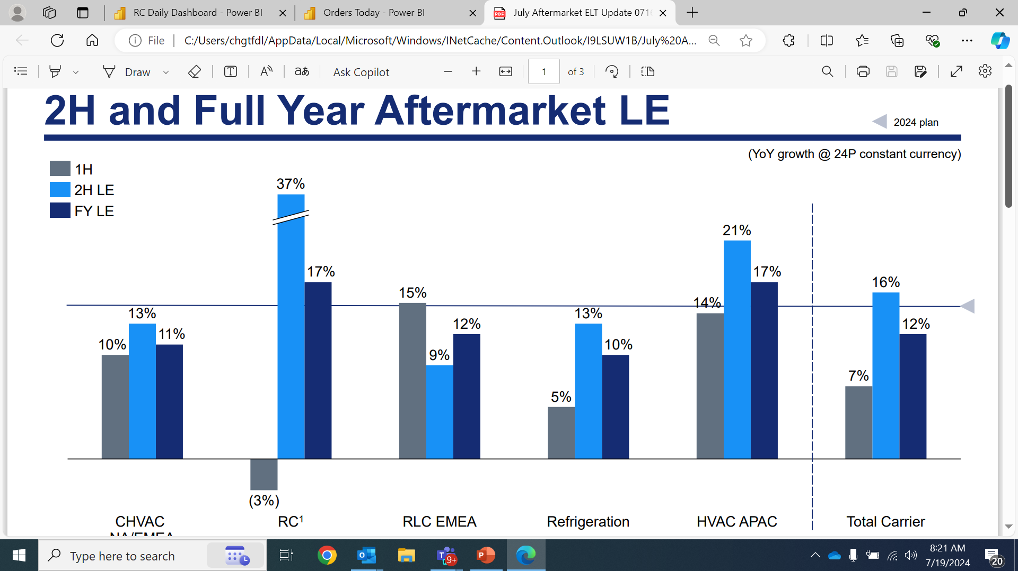
2nd Half and Full Year Aftermarket
Replacement Components
Speaker: Tom Archer
2nd Half & Full Year RC YOY
2nd Half Actions
Operations
  Increase DC supply on Top 1000 parts to 3 month
    $50M investment in inventory
  Increase staff at Kenco DC by 35 people
Sales
  Q3 Purchase program
    Front load orders in the quarter
  Build confidence and loyalty in distribution
    Successful launch of Controls – InteliSense & Entry Wifi
    Regain business lost in SAP transition
    Convert distributor direct to supplier business
Double Digit Growth
Proprietary and Confidential

Slide 20
Distributor Loyalty Program
Replacement Components
Speaker: Tom Archer
Top distribution part % of total revenue
Growth Opportunity
2025 Program
($, millions)
Parts/Equipment Ratio
- All parts
- RLCS & DLS equipment
Loyalty
- Higher P/E = higher rebate
Bonus Incentives
- Rebate range 0.5% - 1%
- Existing DAP funding & growth
- Top 2-3 levels:
- +1% rebalance
- 0.25% wty admin fund
- Above target incremental %
17%
9%
Top ~25 distributors equaling parts / equipment mix of all others
Top distributors
All other
Current
Mix growth
Top Dist. Part mix= to all other
5-year Example: average 18% minimum annual growth @ 30% attainment = ​
~ $350M growth & $20M in rebates​
Proprietary and Confidential
20

Slide 21
Electric Heat Packages
Replacement Components
Speaker: Tom Archer
Current State
- 3 Families of similar product
- CBP OEM Heaters
- ICP OEM Heaters
- Low Current Htrs
- Compete with our supplier
- Tutco direct knock-off
- Warren knock-off
- Poor on hand inventory
Future State
- Consolidate offering
- CBPI OEM Heaters
- Improve on hand inventory
- Improve inventory turns
- Drive customer loyalty
- CBP rebate & partnership
- ICP rebate & partnership
Fan Coil New Platform
- Digital handshake
Proprietary and Confidential

Slide 22
Q&A

Slide 23
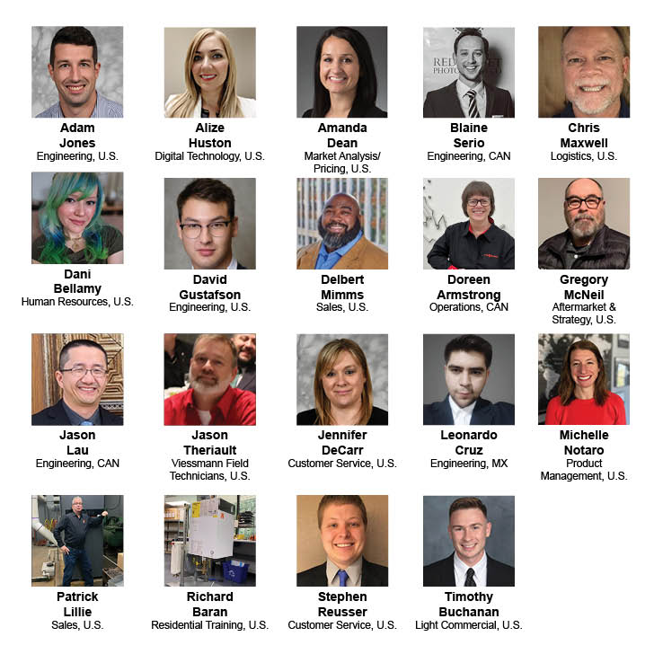


Arch
Nominees
Proprietary and Confidential
Notes:
Now, the moment we’ve all been waiting for! It’s TIME!!! The People’s Choice Award.
Get out your phones!
As a reminder, each quarter you nominate and vote for the employee you feel has demonstrated The Carrier Way values.
19 of your peers were nominated across every department in our the NA Residential Solutions, Light Commercial and Parts BUs
(just read off their first names on the screen)
Adam – Engineering; Alize – Digital Technology; Amanda– Market Analysis/Pricing; Blaine– Engineering; Chris– Logistics; Dani– Human Resources; David– Engineering; Delbert– Sales; Doreen– Operations; Gregory– Aftermarket & Strategy; Jason– Engineering; Jason– Viessmann Field Technician; Jennifer– Customer Service; Leonardo– Engineering; Michelle– Product Management; Patrick– Sales; Richard- Training; Stephen- Customer Service; Timothy- Light Commercial

Slide 24
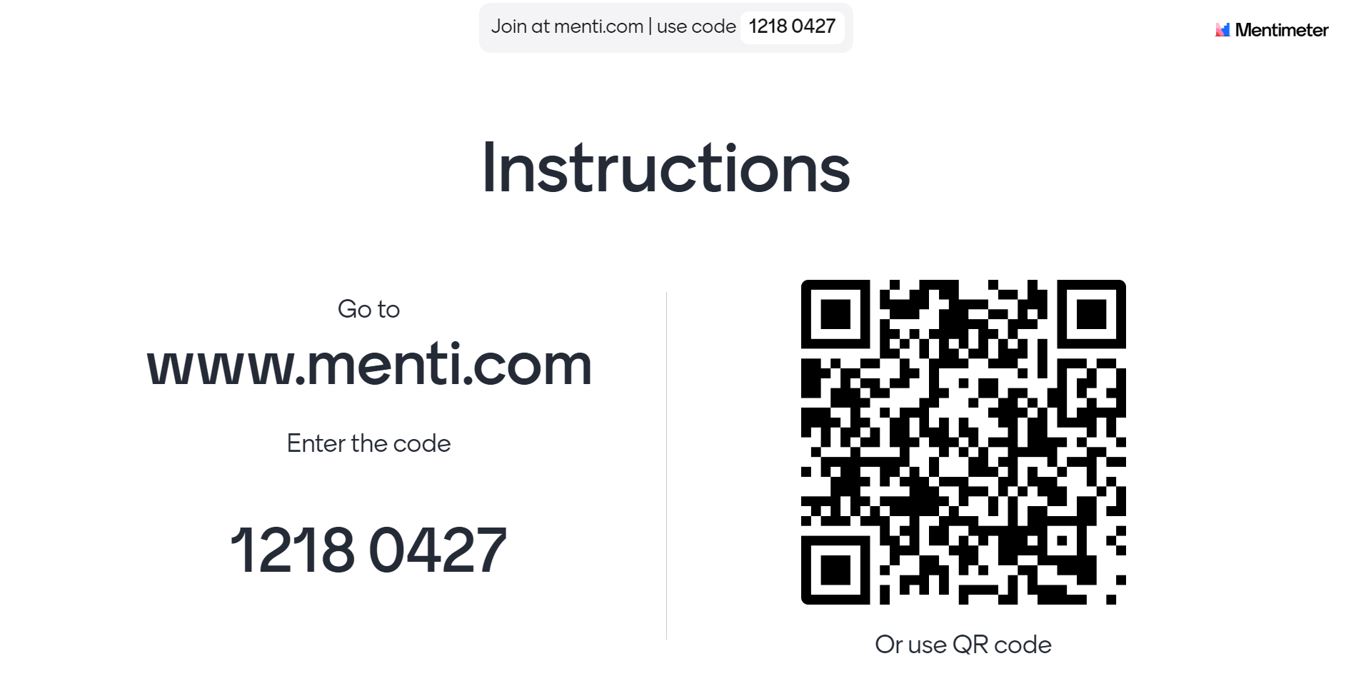
Proprietary and Confidential
Notes:
•To vote, follow the simple instructions on the screen. We’ll give you about 1 minute... and go!
And the winner is...
•Congratulations! The HR and communications team will get back to you on how to receive your monetary prize
•This concludes our town hall. Thank you for all your hard work and continue to have a successful year end and safe holidays to all. Note that Indy attendees to hang out a minute after our meeting for a quick announcement from Amanda Lock.

